Slide 1
Push Button Combination Lock
By: Rohan Nair Roll number: 108075

Slide 2
⤝Contents⤞
Introduction
Circuit Diagram
Components List
Circuit operation / working principle
Applications

Slide 3
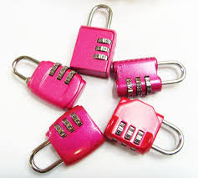

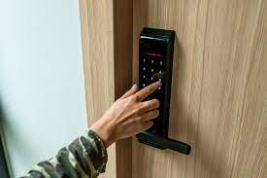
⤝Introduction⤞
Combination locks have been there for decades- and many products such as briefcases and doors are protected by them.
A quality combination lock can secure your valuables away from home or add extra protection to a backyard gate or outbuilding. The best models on the market are portable enough to go anywhere, built to withstand the elements, and imposing enough to ward off thieves.

Slide 4
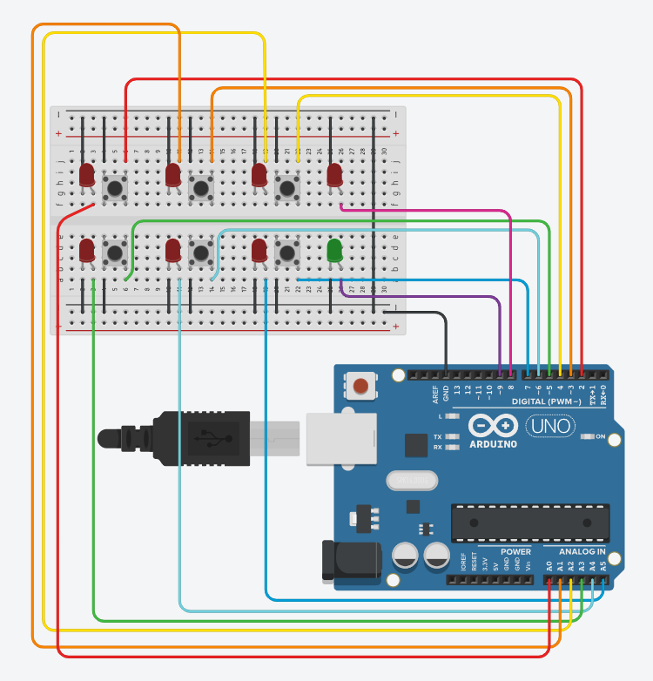
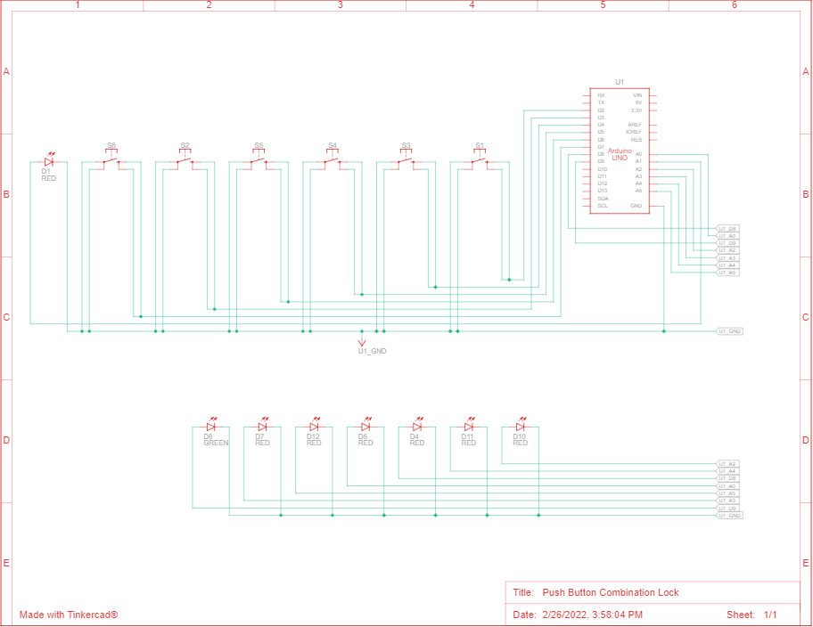
Circuit build-up

Slide 5
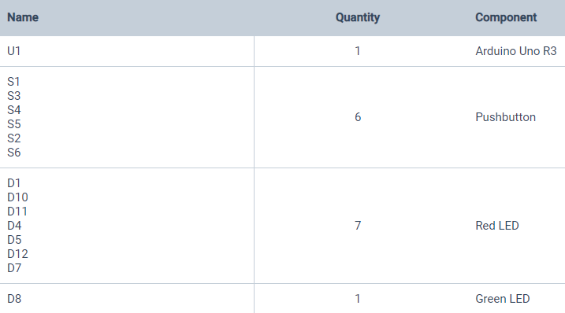
List Of Components

Slide 6
⤝Working of the circuit⤞
The project will help us to set combination passwords and you can set passwords by using 1-6 digits.
The pushbuttons are named as 1,2,3...6. They thus represent the digits in your combination password.
When you push the buttons, and the combination is matched the green LED will be turned on and if the combination is not matched the Red LED will indicate that the password is wrong.
Even if just one digit is wrong, the red LED will glow.

Slide 7
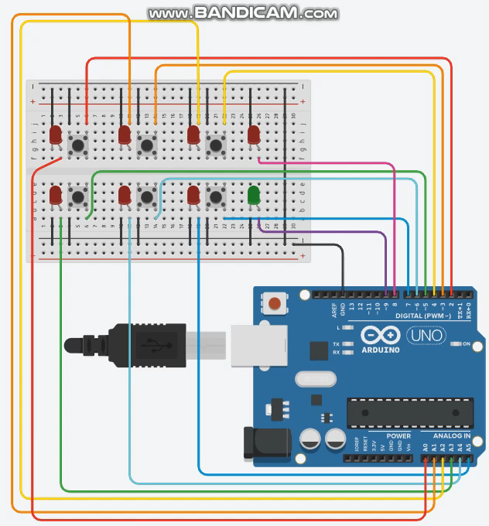
Visual representation

Slide 8
⤝Applications⤞
The increasing rate of crime, attacks by thieves, intruders and vandals, despite all forms of security gadgets and locks still need the attention of researchers to find a permanent solution to the well being of lives and properties of individuals.
To this end, a cheap and effective security system for buildings, cars, safes, doors and gates was designed, so as to prevent unauthorized persons from having access to one's properties through the use of codes, I therefore experimented with the application of electronic components as locks.

Slide 9
Thank You!

